Slide 1
COMMUNITY LIBRARY
- Online portal to make the books available for the needy people.

Slide 2
Underlying Flow of the Application
Donor
Donate books to the library
User Login
Receiver
Request for an available book
Admin
Track all the requests

Slide 3
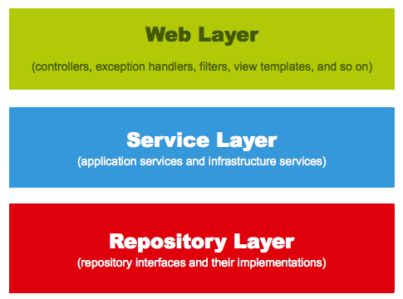
Application’s underlying Architecture

Slide 4
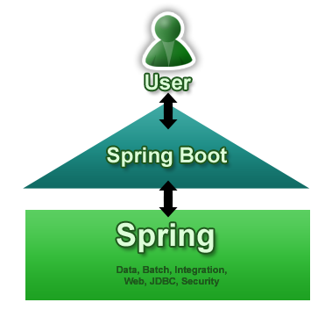
Technology Platform used
Web Front End- Desktop Application
Spring Framework – Service Layer
Hibernate Tools – Generate DDLs
MySQL Database -Database
Maven – build tool
Used STS as IDE to build the application
Code available in GITHub Repository

Slide 5
Project Key Features
Used Annotations based configuration.
Used HikariCP for Connection Pooling -A high performance JDBC Connection pool.
Used Schema Export to generate DDLs from Java class.
MySQLDialect to connect with MySql database.
Written as Spring Boot Application-required only minimal configurations.
Used Spring Data as Repository layer – CRUD Repository
As Maven is used as build tool it can be packed as war file and can be easily deployed

Slide 6
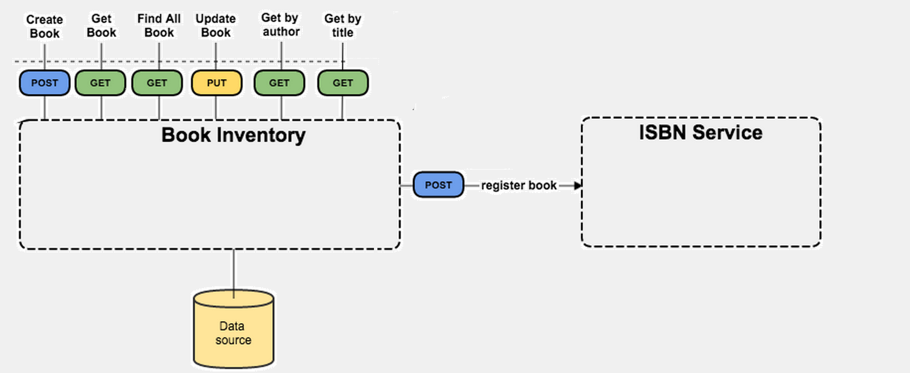
With Inclusion of Rest in Existing Architecture…….
Add Book
/Commlib/<bookISBNNo>/
Get Books
Request /CommLib/Book Request Status/
Response /CommLib/Book Request Status(P/I/R)/Books details
<link uri =/CommLib/Book Request Status(P/I/R)/Books details/
Update Status
Update Books
/CommLib/Book Request Status/Book Details/Update Status/Book ISBN No
Get By Author
Request /CommLib/Author Name
Response /CommLib/Author Name/Books List/
<link uri =/ CommLib/Author Name/Books List/
Request Book
Get Book
/CommLib/Author Name/Request Book/Book ISBN No
Book
Book Request
Book Author
Donor → Create Book Receiver →Get by Author
RegisterBook Get by Academicclass
Get by Title
Get by Genre
Get Book
Admin →Find All Books→Update Book (with Request status)

Slide 7
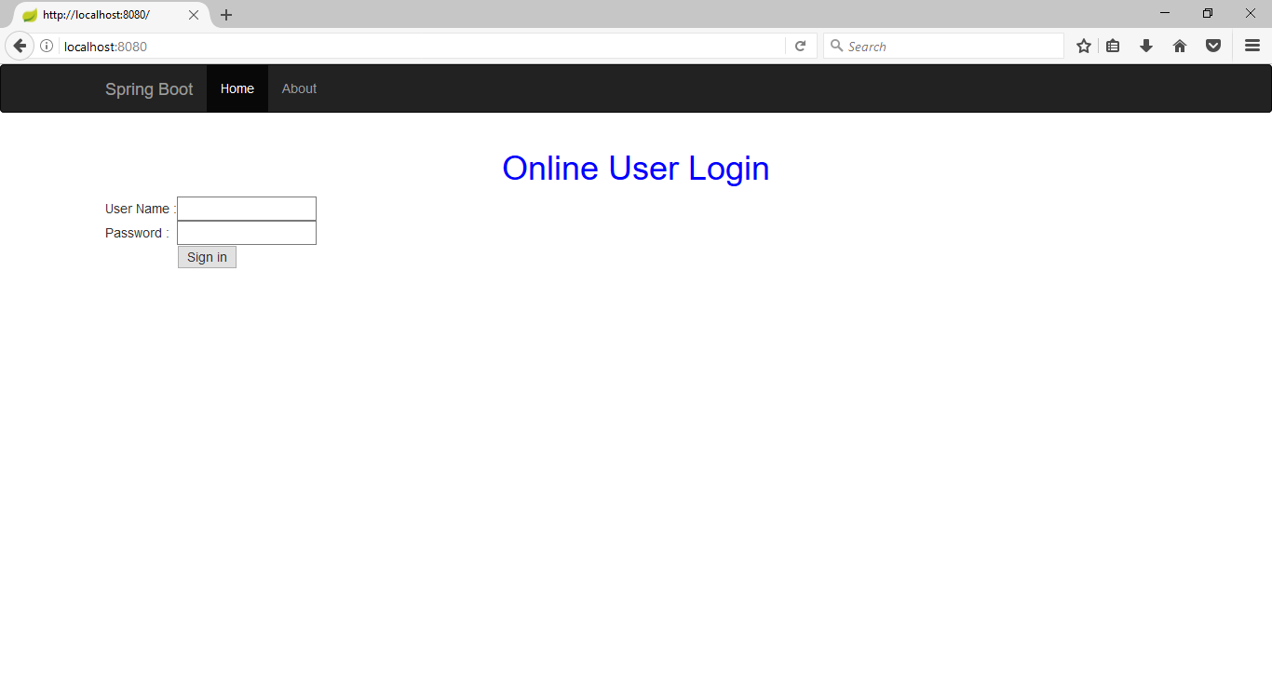
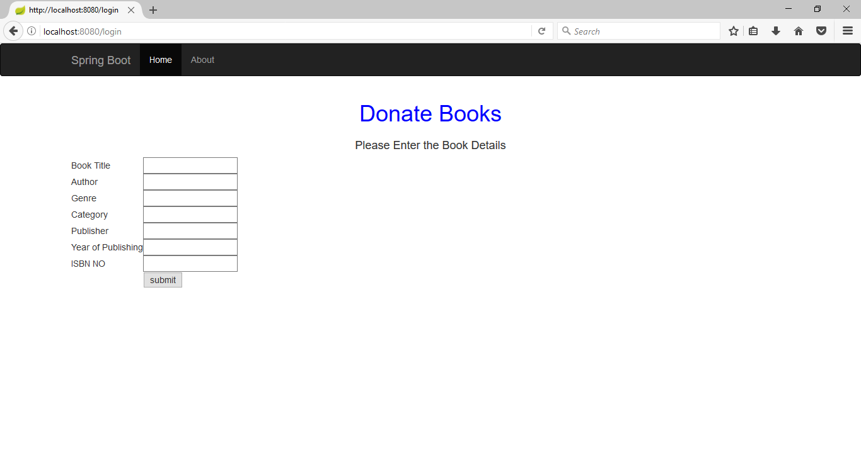
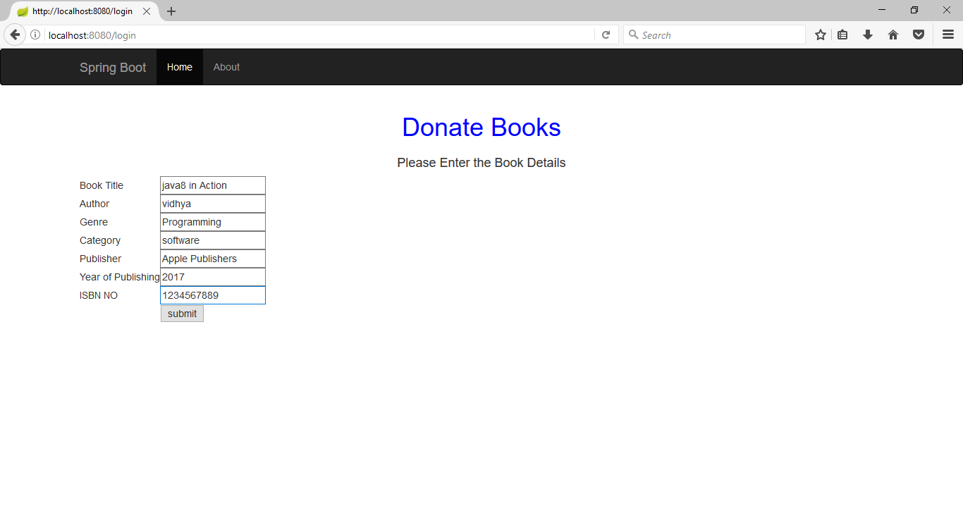
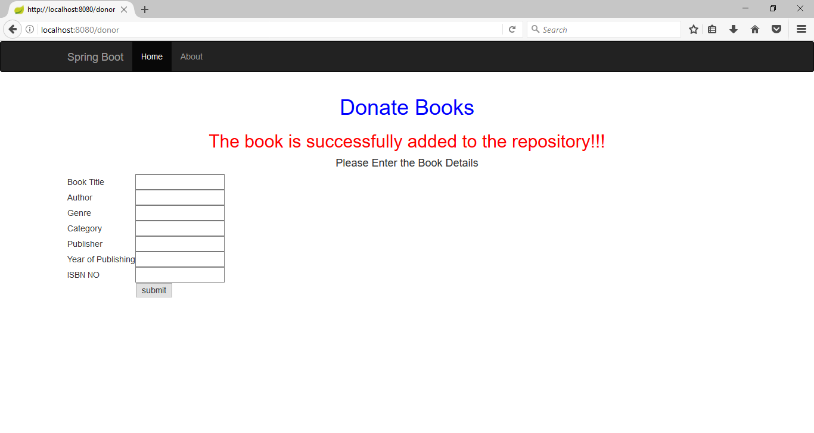

Slide 8
